Slide 1
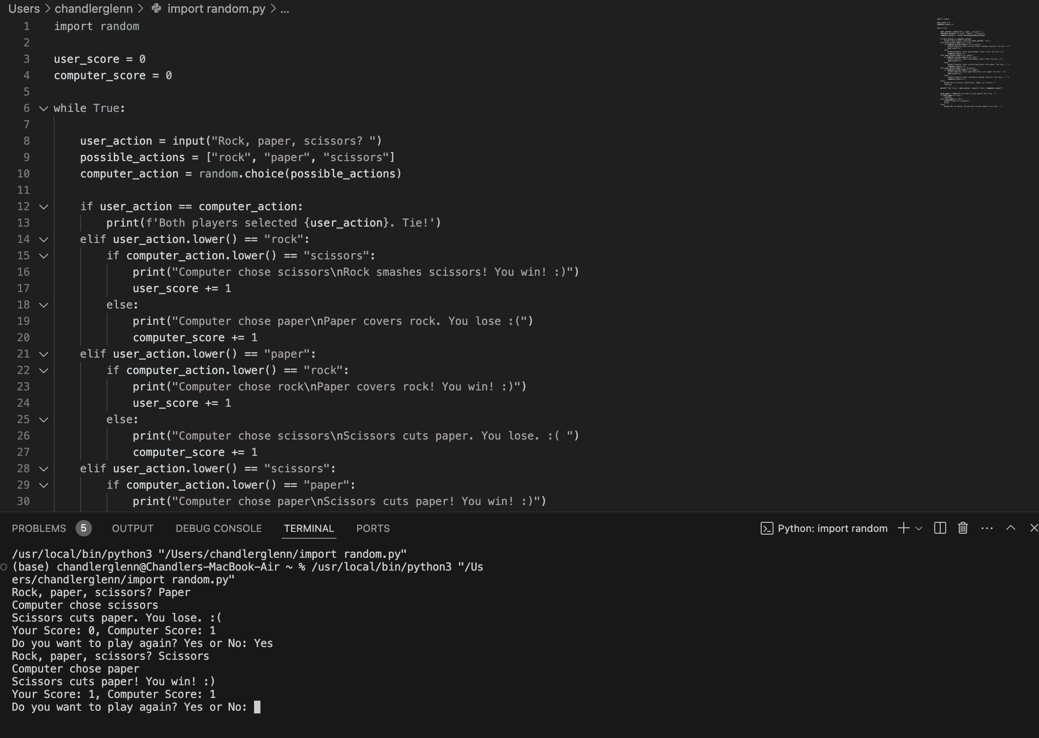
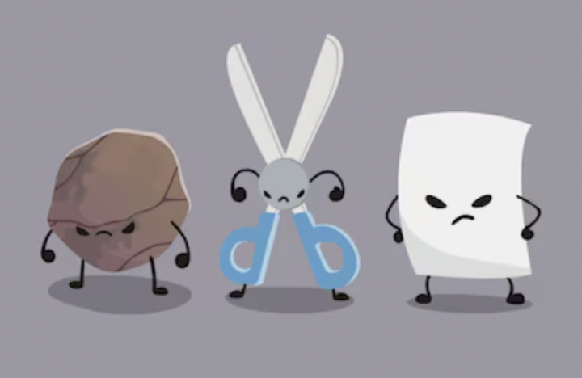
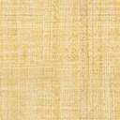
Rock Paper Scissors
Chandler Glenn
I am taking this classic game and modifying it so it keeps track of the score between the user and the computer.
https://github.com/ksu-is/SCISSORS-PAPER-ROCK

